Slide 1



Writing High-Performance C# and .NET Code
d

Slide 2

Who Am I?
Enterprise .Net Architect
Linkedin : in/mguner/
Github : github.com/mertguner
Mert Güner

Slide 3
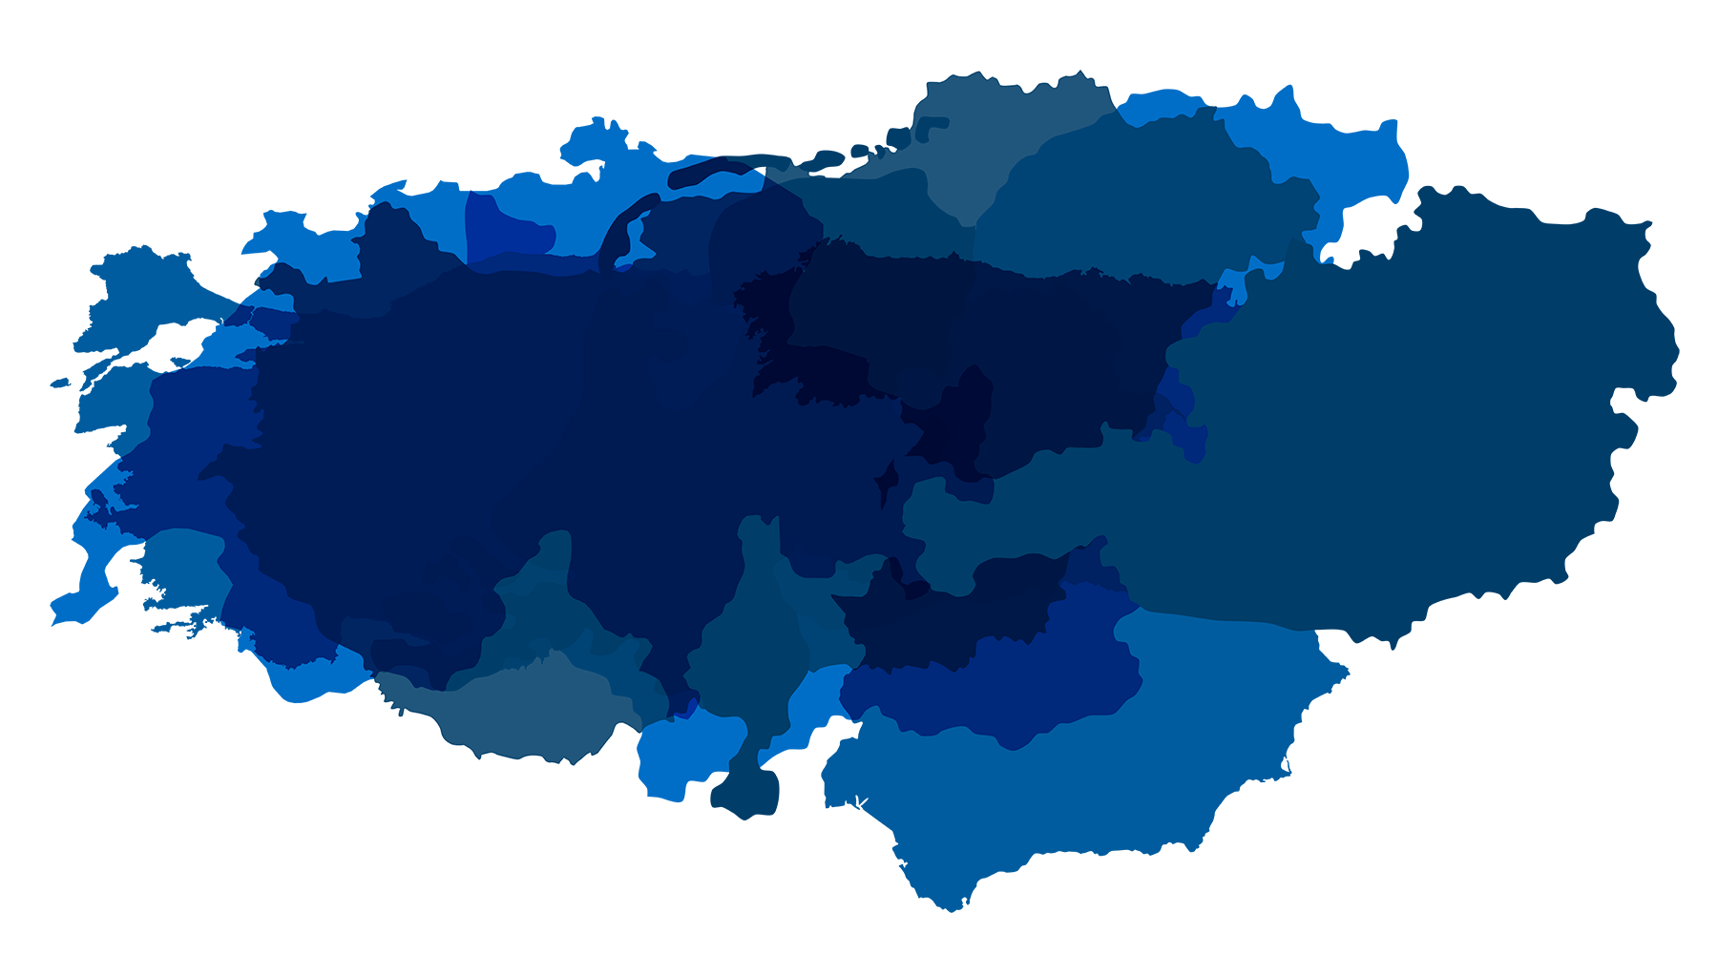

GROWING INTERNATIONALLY
GERMANY |  | AUSTRIA Graz Vienna BULGARIA Sofia Plovdiv DENMARK Copenhagen FINLAND Helsinki HUNGARY Budapest Debrecen Győr Pecs INDIA Kerala | ITALY Lecce Milan NETHERLANDS Amsterdam Nieuwegein ROMANIA Bucharest SWEDEN Boras Gothenburg Malmo Växjö SWITZERLAND Basel Bern Lausanne Lugano St. Gallen Zurich | SPAIN Barcelona Jeréz de la Frontera Madrid TURKEY Istanbul - Maslak Istanbul - ISBI Izmir Ankara UK London SAUDI ARABIA Riyadh
Aachen Augsburg Berlin Bonn Bremen Dortmund Dresden Dusseldorf Essen Flensburg Frankfurt Hamburg Hameln Hannover Jena Karlsruhe Kiel | Cologne Leipzig Much Munich Munster Neumunster Nuremberg Paderborn Potsdam Reutlingen Rostock Saarbrucken Siegen Stralsund Stuttgart Stuttgart-Vaihingen Ulm Walldorf
On the way to becoming a leading IT service provider in Central Europe with
70 offices.
25/05/2024
| 3
Notes:
Slayt sorumlusu: Burak

Slide 4



Attracting talent
10,000+
It’s all about the right people and the right skills.
7,500
5,814
4,975
EMPLOYEES
adesso Group | FTE | *As of September 2023
adesso TR has more than 520 employees in 36 cities.
4,033
2019
2020
2021
2022
2023
25/05/2024
Notes:
The figures for our growing workforce are no less impressive. While there were just over 4,000 adessi in 2019, there are now 7,500 of us in 2022. We are able to attract large numbers of highly skilled and highly motivated people to work for us. People who then channel their expertise and passion for technology and business into our projects.
-------------------------------
Ähnlich gut sieht die Entwicklung der Zahl unserer Mitarbeitenden aus. Waren wir 2019 noch gut 4.000 Kolleginnen und Kollegen, begrüßten wir 2022 adessi Nummer 7.500.
Es gelingt uns im großen Maßstab kompetente und motivierte Menschen an Bord zu holen. Menschen, die ihr Fachwissen und ihre Leidenschaft für Technologie und Business in Projekte einbringen.

Slide 5






Services | business to technology
Translating technology into business. From strategy to operation – and everything in between.
BUSINESS
CONSULTING
IT
CONSULTING
SOFTWARE DEVELOPMENT
IT MANAGEMENT
STRATEGY > PROZESS
PROZESS > ARCHITECTURE
ARCHITECTURE > APPLICATION
APPLICATION > OPERATION
Notes:
The spectrum of services we provide ranges from strategic and technological consulting to software development, implementation and operation. The main focus is on defining and implementing IT-supported business models and processes and developing suitable applications.
------------------------------
Unser Leistungsspektrum reicht von der strategischen und technologischen Beratung über Softwareentwicklung und -implementierung bis zum Betrieb. Schwerpunkte sind das Definieren und Umsetzen von IT-unterstützten Geschäftsmodellen und -prozessen sowie das Entwickeln passender Anwendungen.

Slide 6

Agenda
1
Introduction and Overview
2
Testing, Monitoring, and Continuous Improvement Strategies
3
Code Optimization Techniques
4
Parallelization
5
Sample Applications and Scenarios
6
Summary and Next Steps

Slide 7
Introduction and Overview
Competitive Advantage
The Importance of Performance
Competitive Advantage
System Efficiency
Cost
Cost
System Efficiency

Slide 8


Introduction and Overview
C# and the Role of Performance in .NET
Features Offered by .NET
.NET offers extensive libraries
a powerful JIT (Just-In-Time) compiler
a modern language like C#
JIT Compiler and Performance
Memory Management and Performance
NET automates memory management through garbage collection mechanisms
Performance-Oriented Features of C# Language
instance, value types, structs, and spans

Slide 9
Testing, Monitoring, and Continuous Improvement Strategies
Optimize
Measure
Optimize
Measure
Optimization Cycle
Measurement
Visual Studio Profiling
dotTrace
dotMemory
Benchmark.Net
Optimization
……

Slide 10
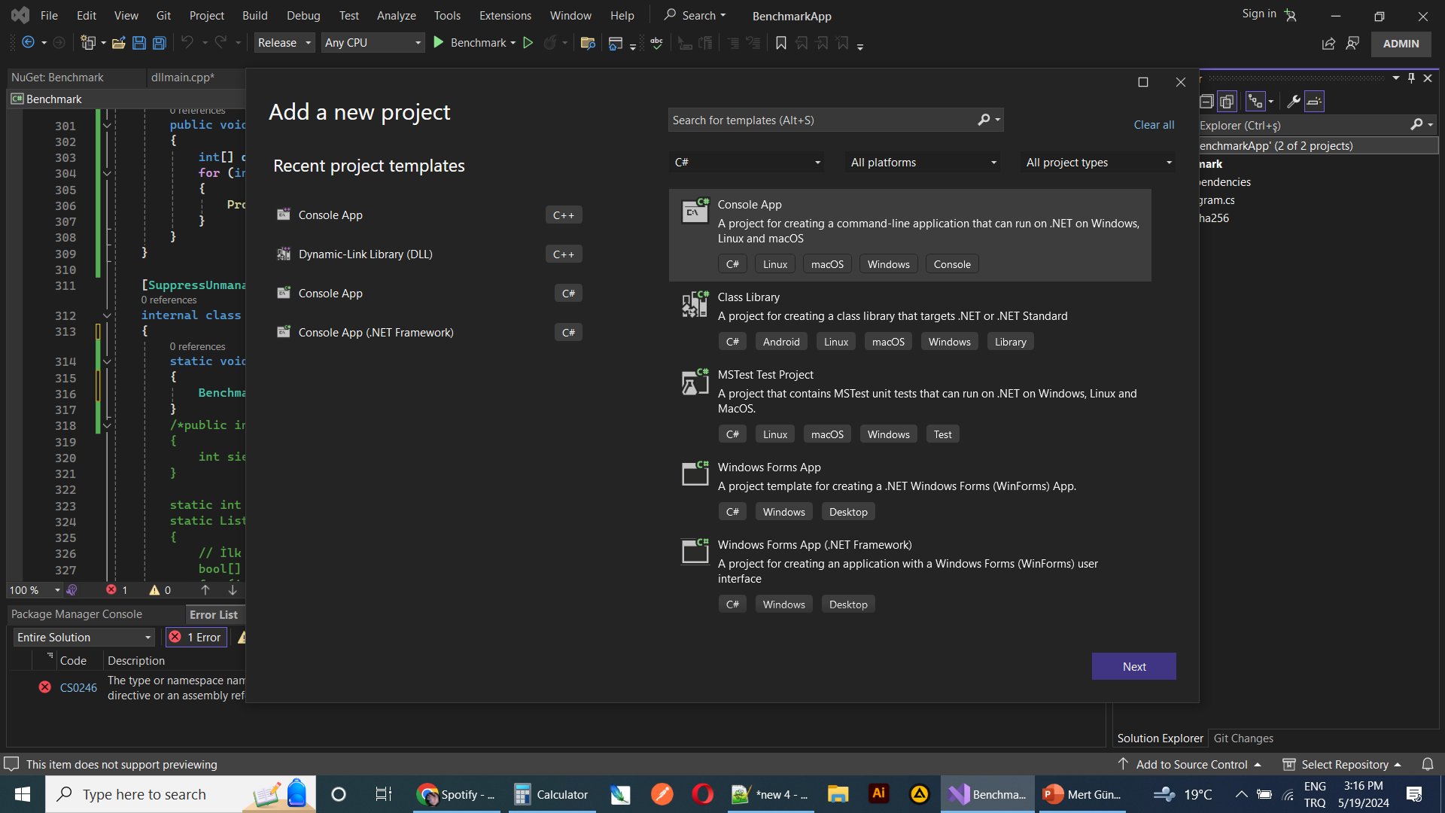
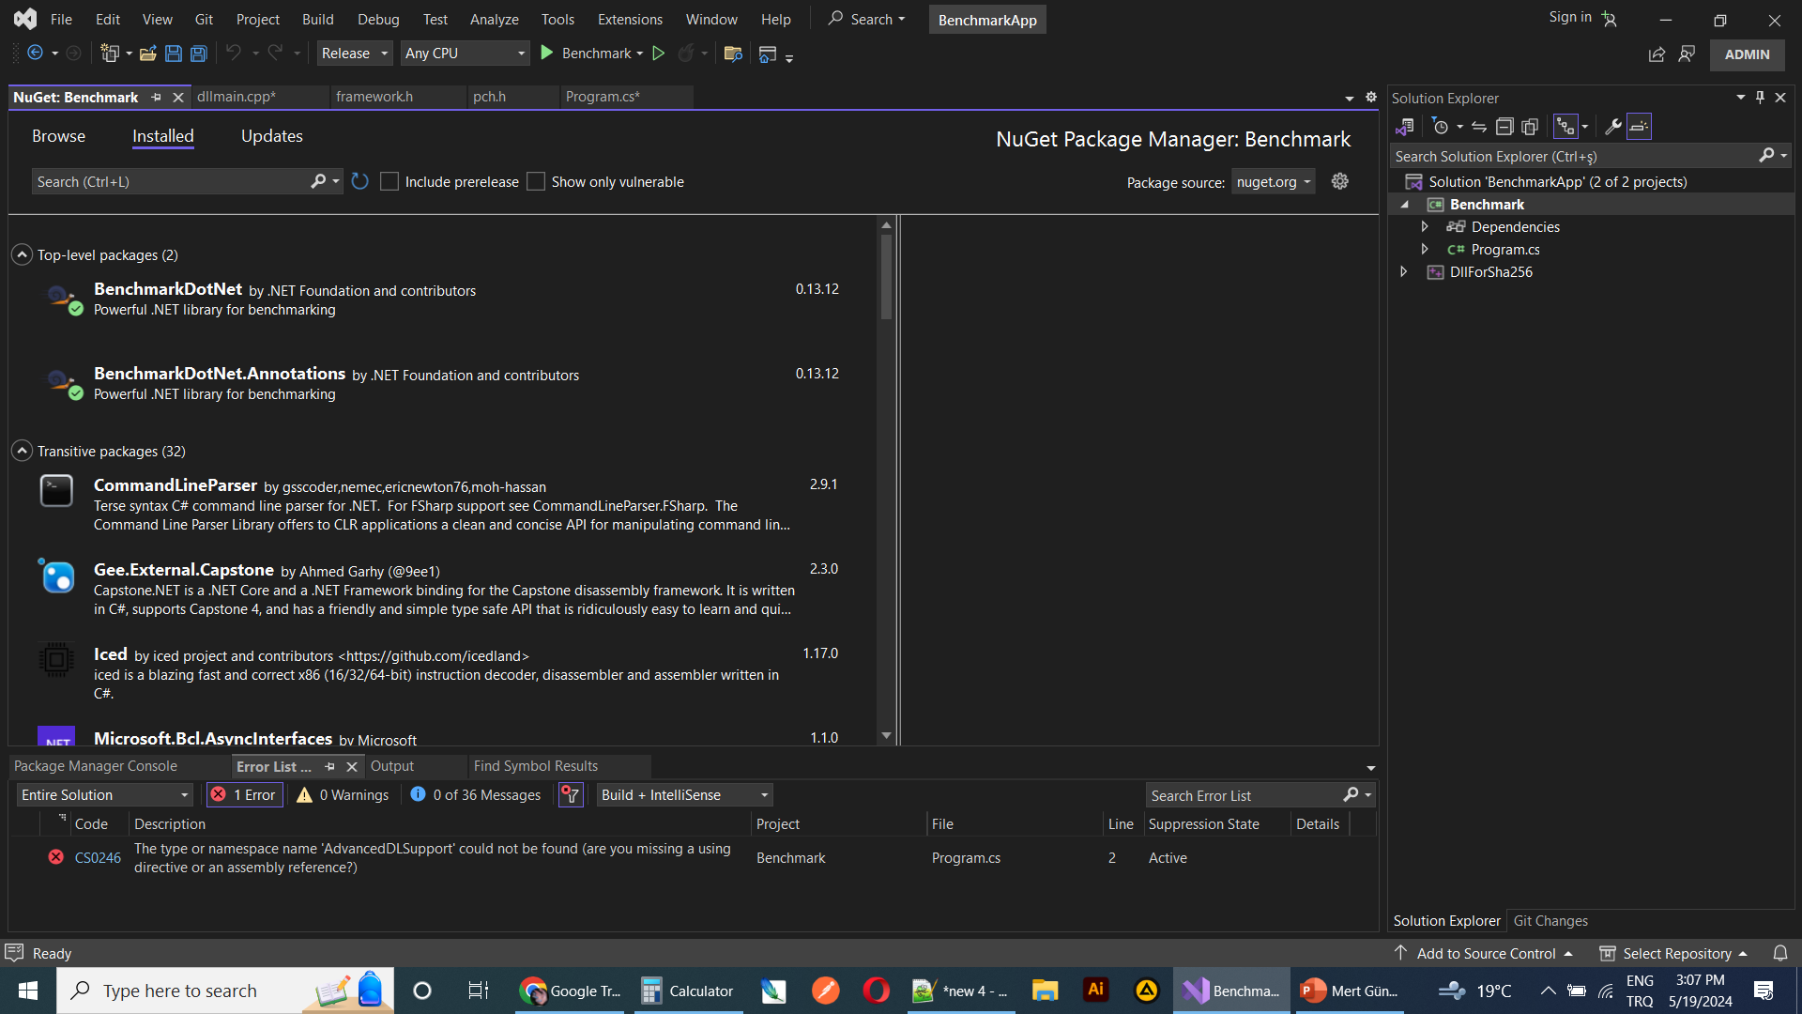
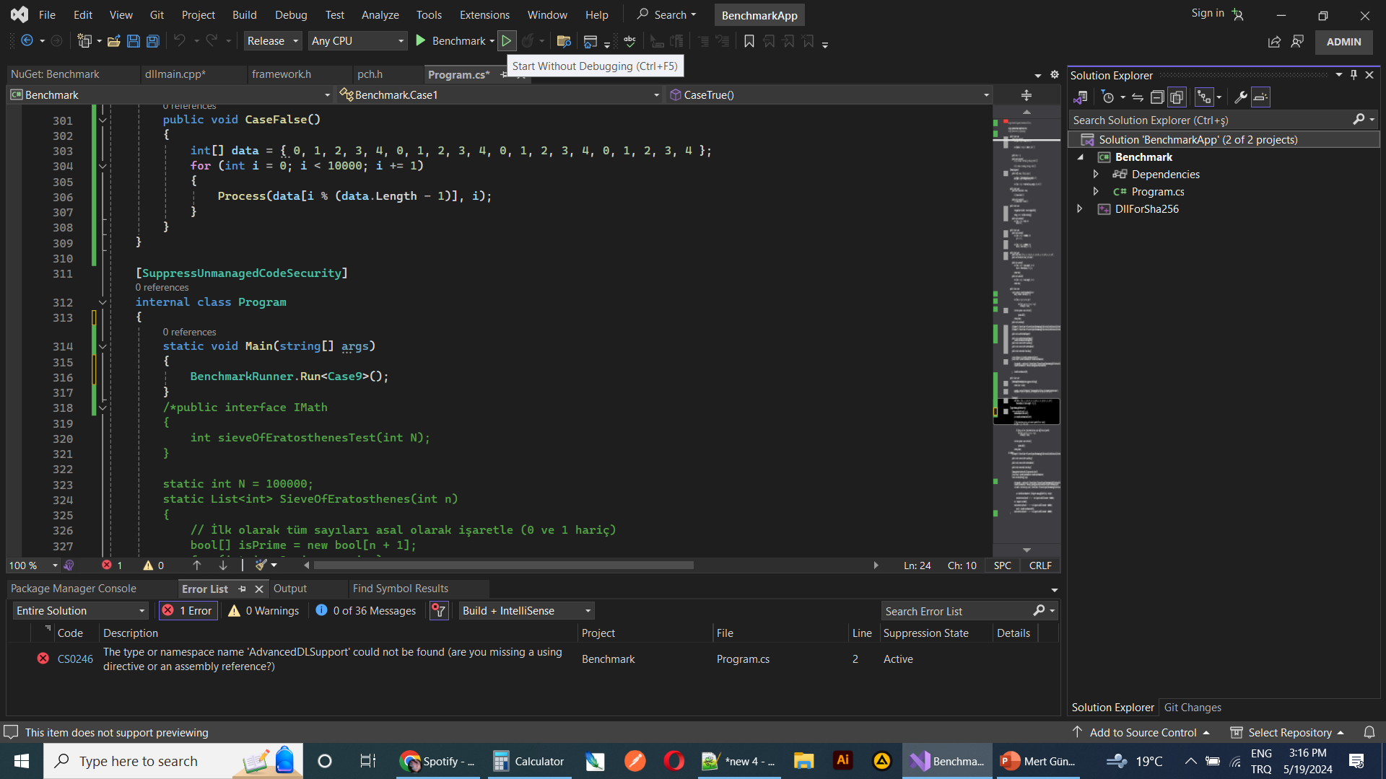
Benchmark.Net
public class Case1
{
[Benchmark]
public void CaseTrue()
{
}
[Benchmark]
public void CaseFalse()
{
}
}
Manage NuGet Packages
static void Main(string[] args)
{
BenchmarkRunner.Run<Case1>();
}

Slide 11
Code Optimization Techniques
Optimization of Cycles and Conditions
False
True
Performance Benchmarking
for (double i = 0.0; i < 1000.0; i++) {}
for (int i = 0; i < 1000; i++) {}
942.2 ns
| 252.7 ns = x3.72
if (x > 0 && x < 10 && y > 0 && y < 10) { }
if ((x > 0 && x < 10) && (y > 0 && y < 10)) { }
0,0008ns
| 0,00001ns = x80
int limit = ((int)Math.Pow(array.Length, 2));
for (int i = 0; i < limit; i++) {}
for (int i = 0; i < Math.Pow(array.Length, 2); i++) {}
1000ns
| 41ns = x24.3
List<int> numbers = new List<int> { 1, 2, 3, 4, 5 };
if (numbers.Contains(i))
HashSet<int> numbers = new HashSet<int> { 1, 2, 3, 4, 5 };
if (numbers.Contains(i))
313.6ns
| 251.2ns = x1.2

Slide 12
Testing, Monitoring, and Continuous Improvement Strategies
Optimize
Measure
Optimize
Measure
Optimization Cycle

Slide 13
Code Optimization Techniques
Optimization of Memory Usage
False
True
using (var stream = new FileStream("dosya.txt", FileMode.Open)) {
}
var stream = new FileStream("dosya.txt", FileMode.Open);
Point p = new Point();
for (int i = 0; i < 1000000; i++)
{
p.X = i;
p.Y = i + 1;
}
for (int i = 0; i < 1000000; i++)
{
Point p = new Point(i, i + 1);
}

Slide 14
Code Optimization Techniques
Optimization of Memory Usage
False
True
Performance Benchmarking
StringBuilder builder = new StringBuilder();
for (int i = 0; i < 100; i++)
{
builder.Append(i);
}
string result = builder.ToString();
string result = "";
for (int i = 0; i < 100; i++)
{
result += i;
}
2.947 us
| 1.247 us = x2.36

Slide 15
parallelization
for (int i = 0; i < 5; i++)
{
Process(i);
}
Process
Process
Process
Process
Process
Time
Process
Parallel.For(0, 5, i => {
Process(i);
});
Process
Process
Process
Process
Time

Slide 16
Sample Applications and Scenarios
Sample = HMACSHA512
Auth
Body
{
“value01”: "red",
“value02”: 28
}
7258b36485526accd4c482ec080db985069ec8f01de87f1d4d063e8be9f54e0bc6dfea053bb8151676ba2aaa23728df51d6ac65264015c3bfd2fd1f8b97f8c27
HMACSHA512
Token
Gateway
Core
Body
6ms
Customer
Saniyede 1000 istek
Account
1000 / 6 = 166 adet
4 pod = 700 – 800 arası istek

Slide 17
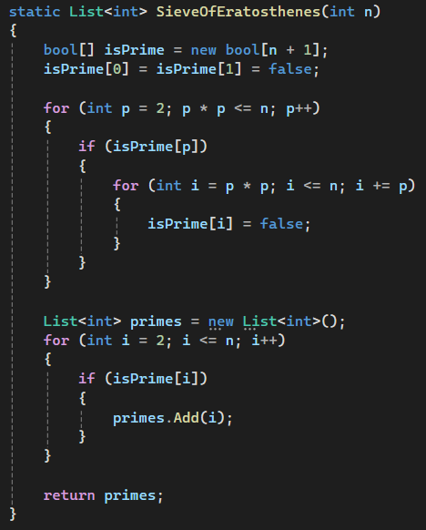
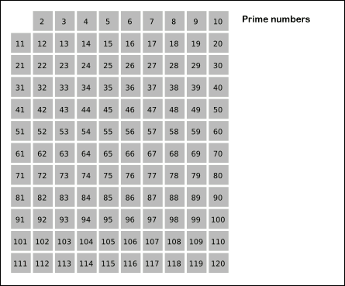
Sample Applications and Scenarios
Sample = Sieve of Eratosthenes

Slide 18
Sample Applications and Scenarios
C# Code Execution Process
C# Memory Management
C# Source Code
Memory Allocations
Compile to IL Code
Monitored by Garbage Collector
C
.NET Runtime (CLR)
Garbage Collection Operation
JIT Compiler
Machine Code
Execution

Slide 19
Sample Applications and Scenarios
Code Execution Process
Memory Management
C#
C++
C#
C++
C# Source Code
C++ Source Code
Memory Allocations
Memory Allocations
Compile to IL Code
Compile to Machine Code
Monitored by Garbage Collector
Developer Control
.NET Runtime (CLR)
Execution
Garbage Collection Operation
JIT Compiler
Machine Code
Execution

Slide 20
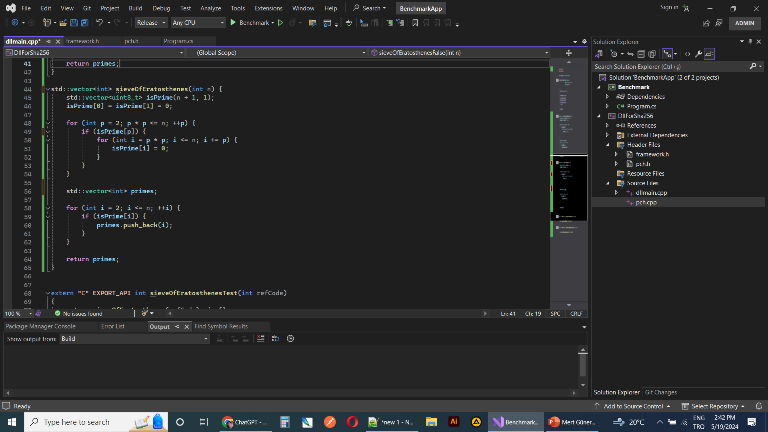
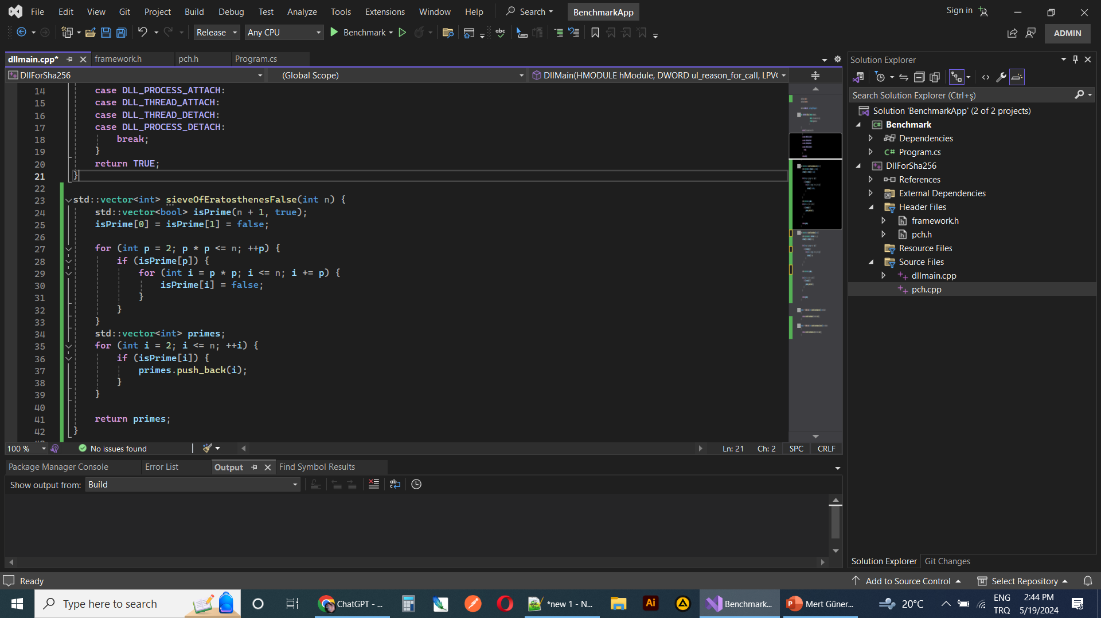
Sample Applications and Scenarios
Answer = Sieve of Eratosthenes
With ChatGPT

Slide 21
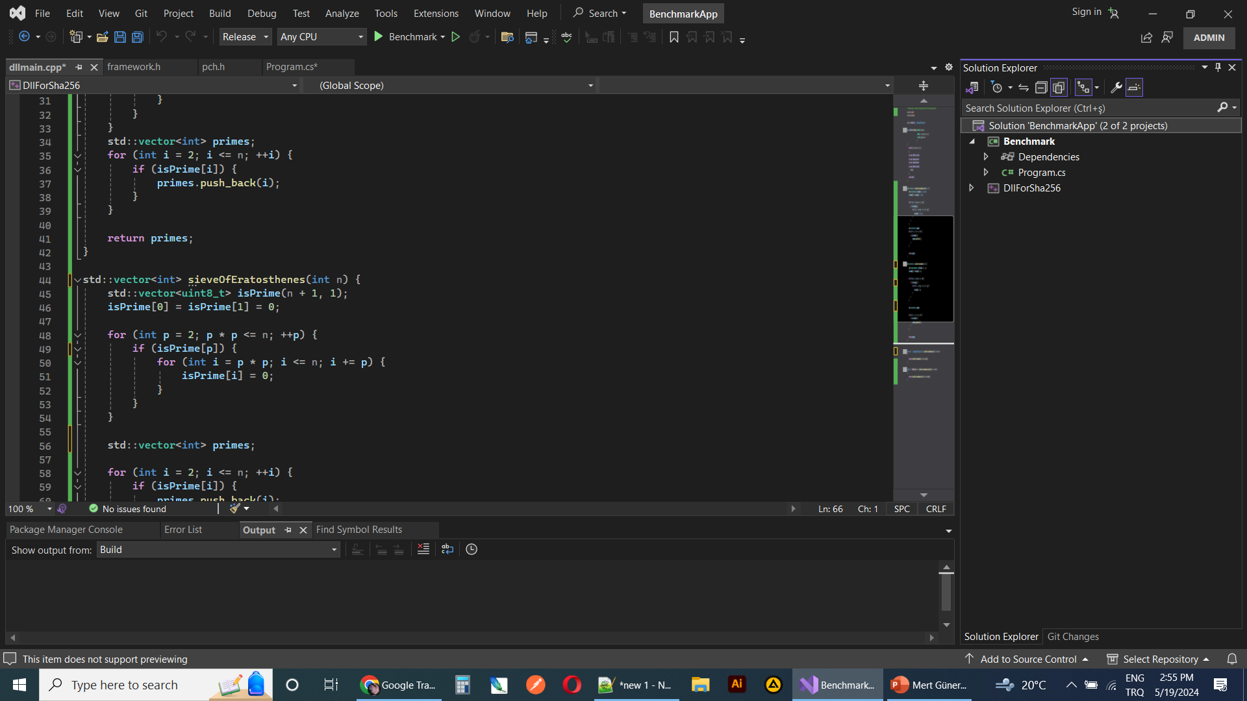
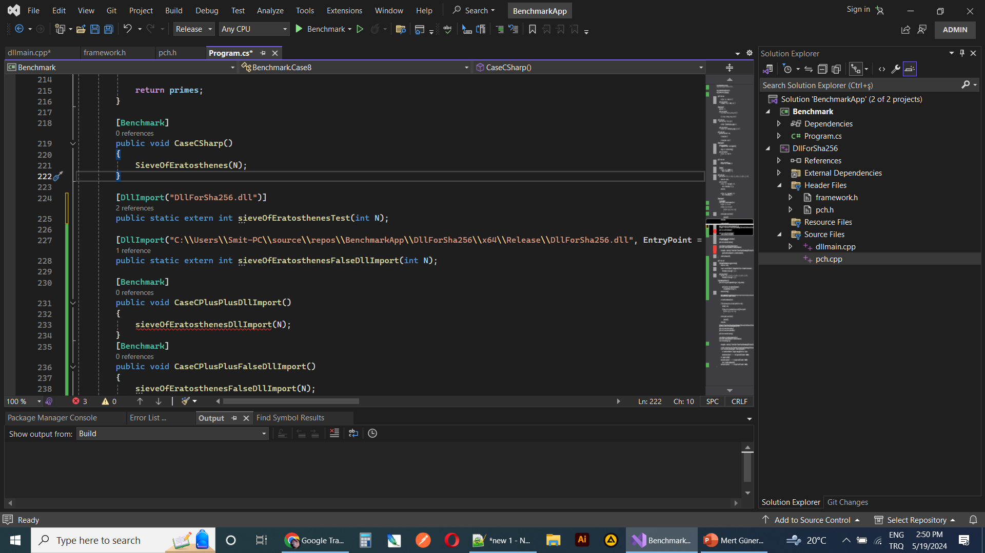
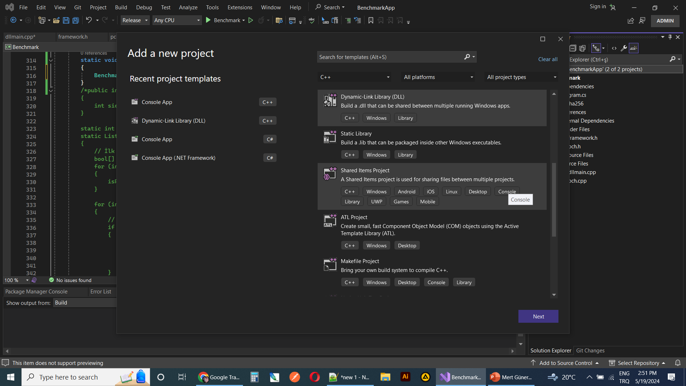
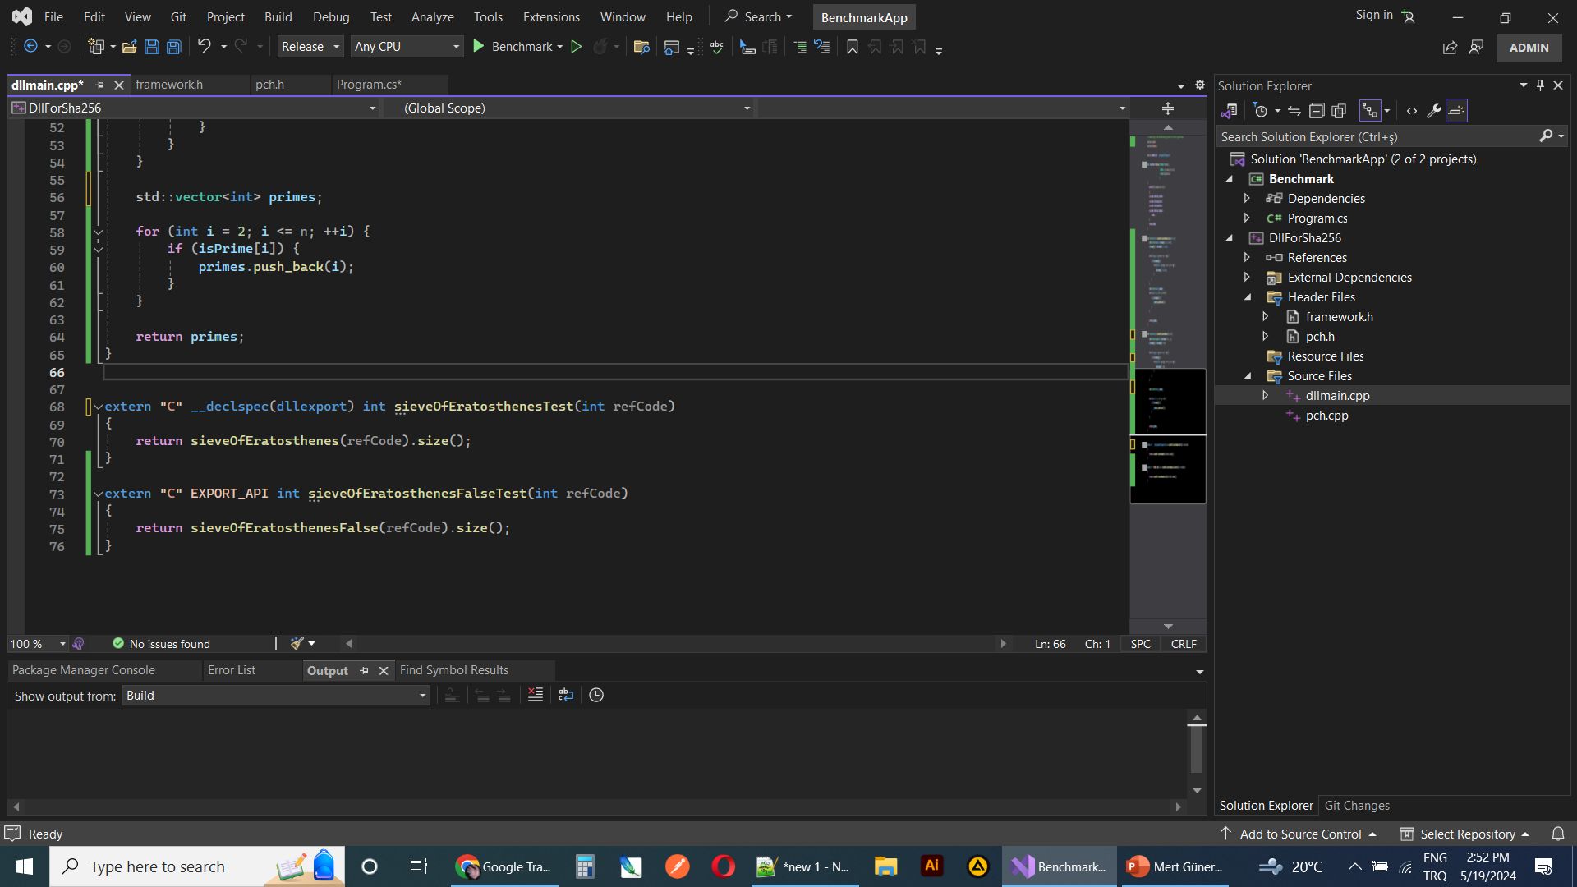
Sample Applications and Scenarios
Answer = Sieve of Eratosthenes
C#
HMACSHA512
4ms
1000 / 4 = 250 adet
4 pod = 1100 – 1200 arası istek

Slide 22
Sample Applications and Scenarios
Answer = Sieve of Eratosthenes
Method | N | Mean | Error | StdDev | Allocated
CaseCSharp | 1000000 | 3.829 ms | 0.2206 ms | 0.0121 ms | 2049212 B
CaseCPlusPlusTrue | 1000000 | 2.771 ms | 0.5431 ms | 0.0298 ms | 2 B
CaseCPlusPlusFalse | 1000000 | 3.808 ms | 0.6354 ms | 0.0348 ms | 3 B

Slide 23
Summary and Next Steps
Unity Render Texture To Video
1920
Convert To ByteArray
24 fps = 189.84 MB
FFMEG
1080
15% more processing time
25% Up
Camera
Render Texture
Convert To ByteArray Without Alpha
24 fps = 142.32 MB
1 Pixel =
R
G
B
A
A
1920x1080 = 7.91 MB
Pointer
C++ Lib
24 fps = 142.32 MB
Assembly
25% performance increase from data size
75% assembly + c++ Lib
100% overall performance increase
1 Pixel =
R
G
B
1920x1080 = 5.93 MB

Slide 24

Writing High-Performance C# and .NET Code
Many thanks!
Github : github.com/mertguner
adesso SE
Adessoplatz 1
44269 Dortmund
Germany
T +49 231 7000-7000
F +49 231 7000-1000
www.adesso.de/en

